Slide 1

Introduction to Unity
Learning the basics

Slide 2
What is Unity?
Unity is a free to use game development engine, capable of both 2D and 3D games, and even mobile games and interactive presentation style software.
It is great for Indie projects with stylised graphics, being easier to run than Unreal.
It’s simple and user friendly in its layout and navigation and uses C# scripting and object-oriented principles in its programming and creation process. Which, in short, is an easy place to start learning programming when you’re a complete beginner.

Slide 3
Unity Pros and Cons
Pros
User friendly, simple clean engine interface. Great for beginners.
Versatile – Can develop 2D, 3D and for mobile, console and PC.
Scripting with C# is generally considered a simpler language to approach.
A lot of guides, tutorials and learning material available.
A big asset store with tonnes of free assets.
Cons
Not as strong as other game engines for high fidelity realistic graphics.
It can be easy for scripts and components to become messy in larger projects.
Not open source and has had some poor decisions from leadership of the company in the past.

Slide 4



Are there any games I might have heard of that were made using Unity?
Genshin, HSR and Zenless Zone Zero

Slide 5


Are there any games I might have heard of that were made using Unity?
Pokemon GO and Subway Surfers

Slide 6


Are there any games I might have heard of that were made using Unity?
Hollow Knight and Silksong

Slide 7



Are there any games I might have heard of that were made using Unity?
Among Us, Lethal Company and Schedule 1

Slide 8
Setting up before you open Unity
First, create and account on the Unity website to get started.
Second, download the Unity Hub and log in there. Then, go to the licenses tab and get yourself a free personal license.
From the hub, download the editor version 6000.2.13f1 (we will be using this for the course!)
You’re then ready to start a new Project!

Slide 9
Starting the project
Go to the Projects tab in Unity Hub and click New Project.
From there, click Universal 3D, give it a name like YourName_Unity and make sure it’s saved to a good location.

Slide 10
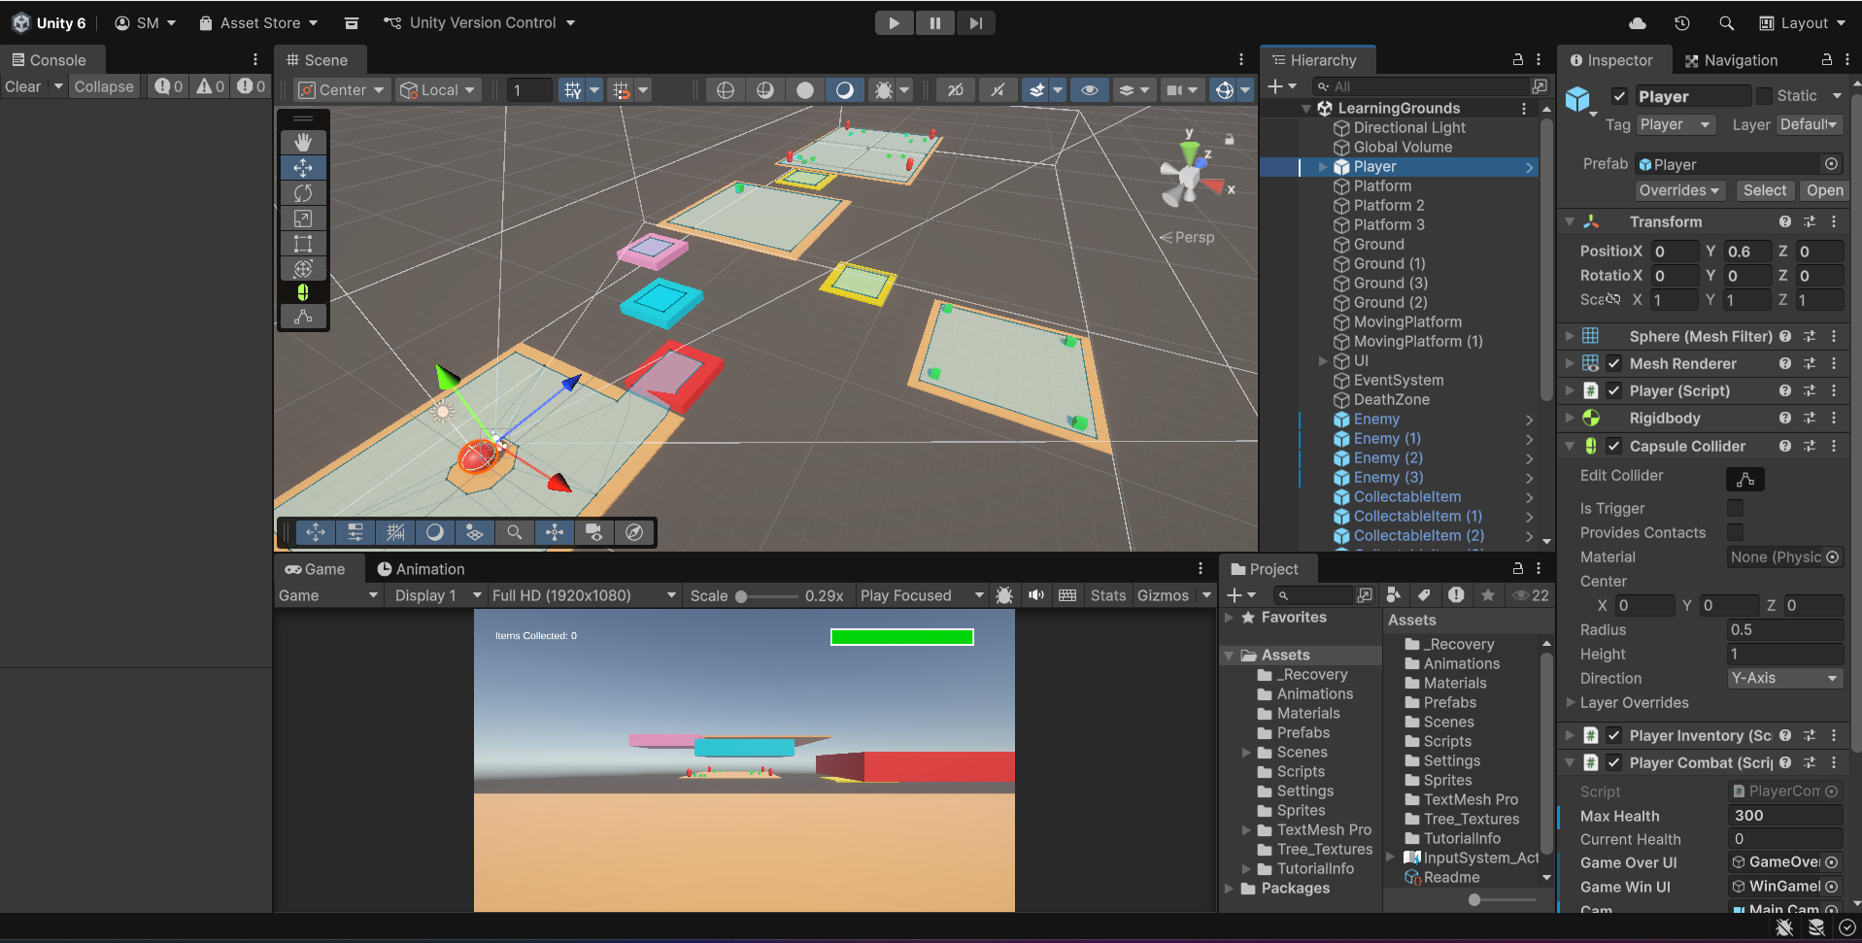
Exploring the Layout

Slide 11
Some Unity terms
GameObject – just objects in your game, you can see these in the Hierarchy window and move them in the Scene window.
Component – things you attach to a GameObject like colliders and scripts. When you click on a GameObject, the Inspector window will show the components, and you can edit them there.
Script – this is just a code file, in Unity, it will be written in C#. We will write scripts and attach them to various GameObjects.
Prefab – a preconfigured GameObject that can easily be placed in multiples around your scene and created or destroyed in code.

